Slide 2
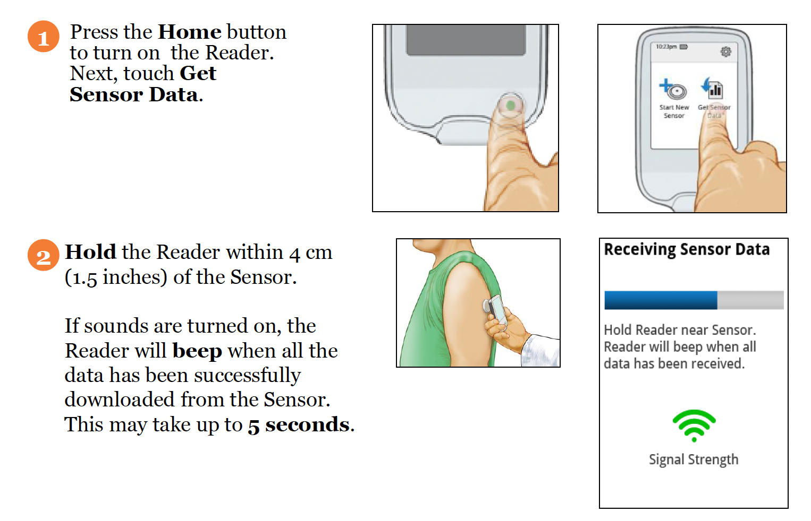
Scanning the sensor using the reader
Scan once a day to check sensor is functioning well.

Slide 3
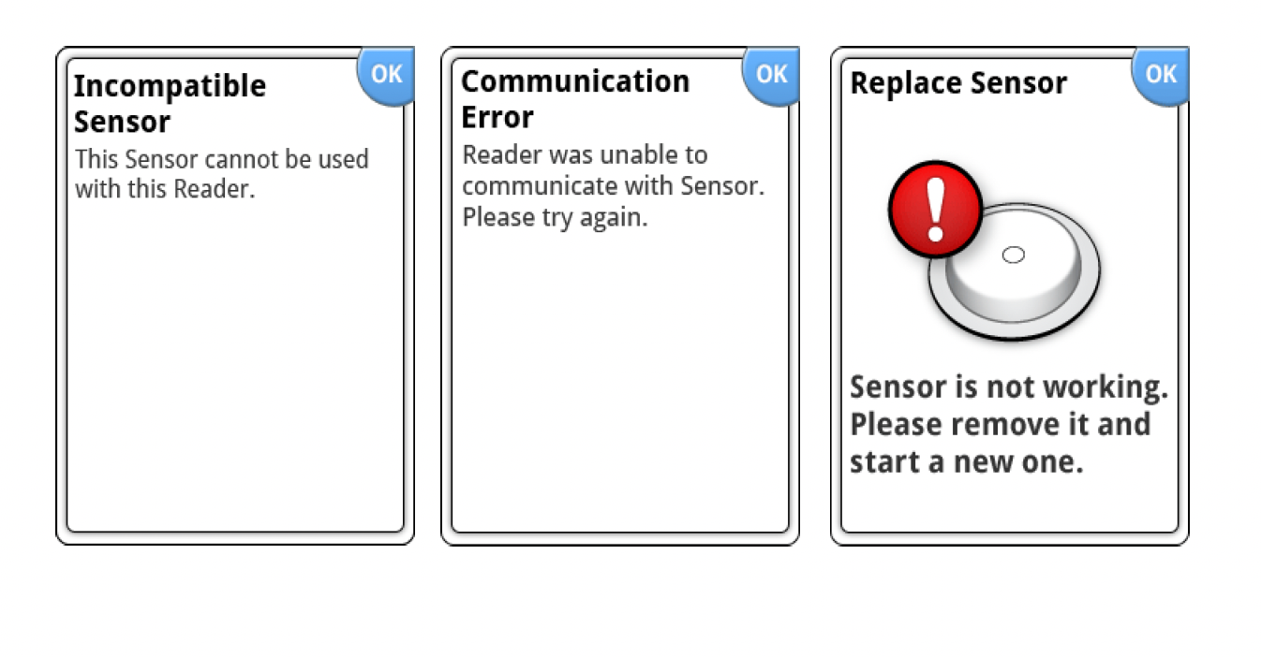
Potential notifications
Contact us for replacement if you encounter any of the following error messages!

